Slide 1
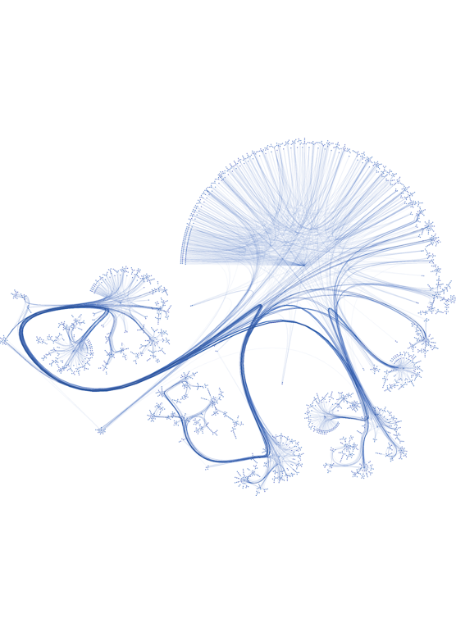
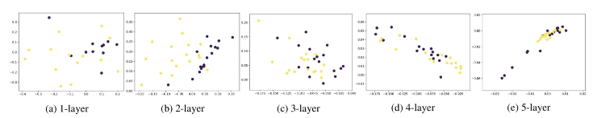
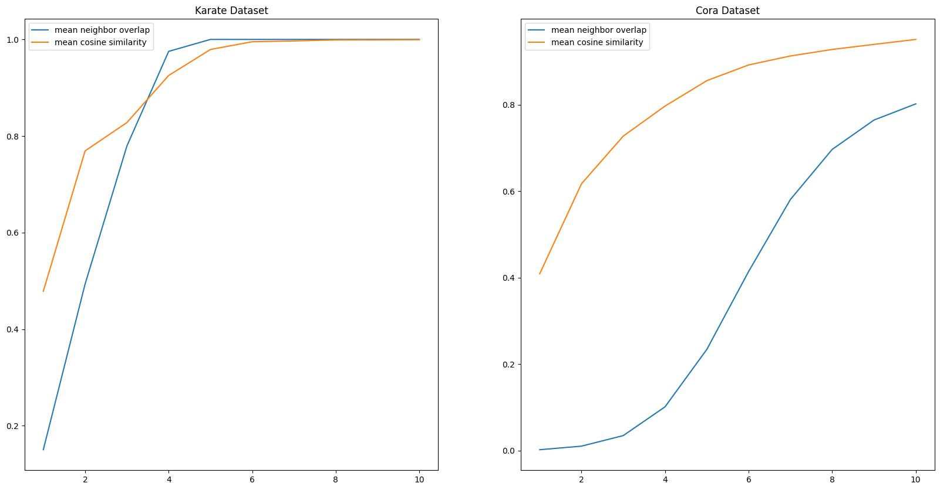
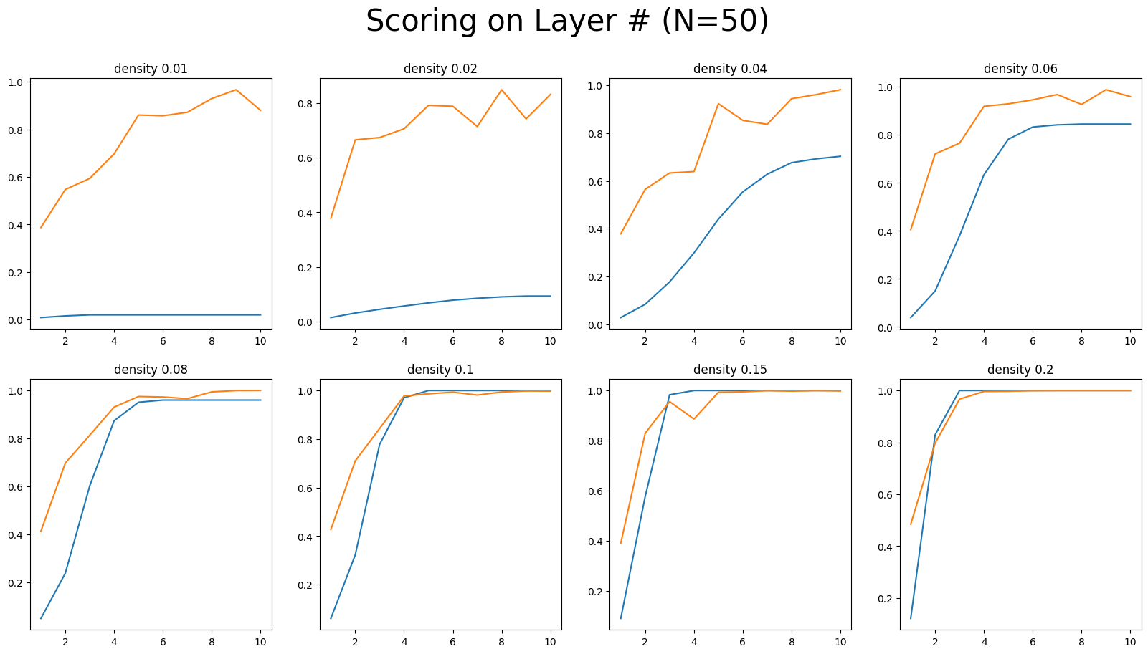
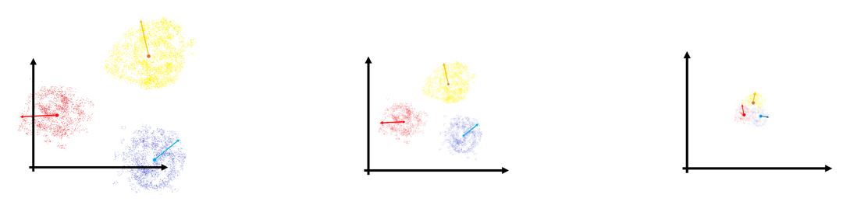
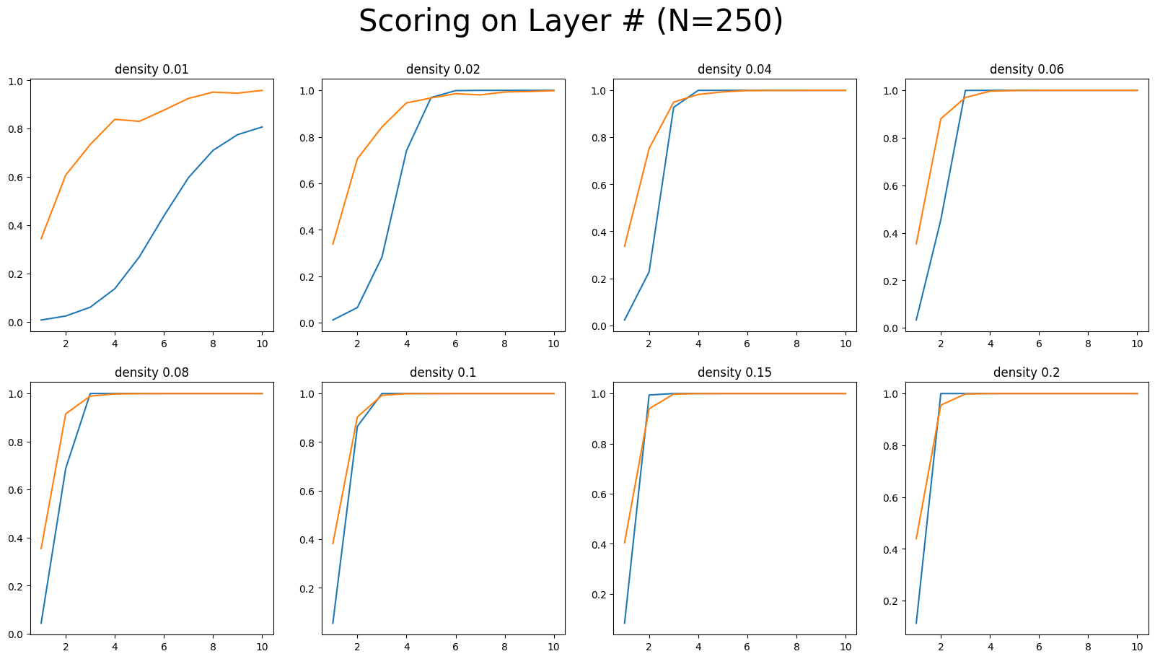
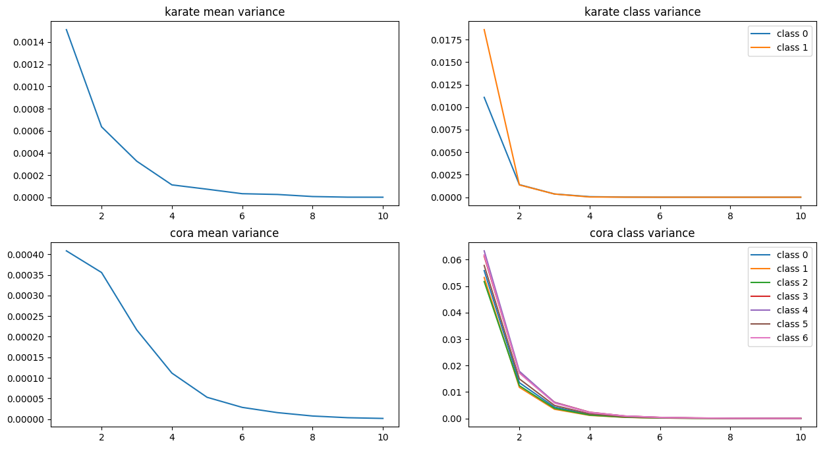
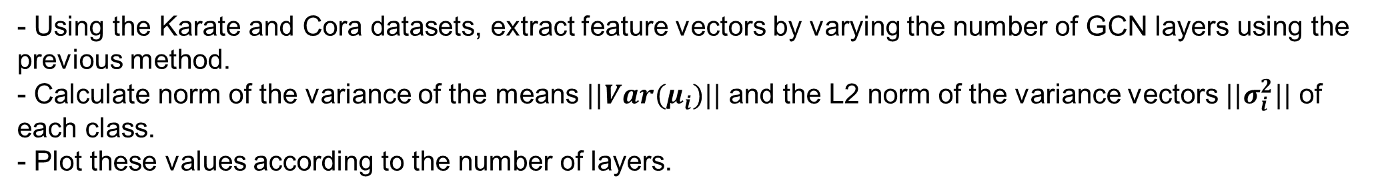
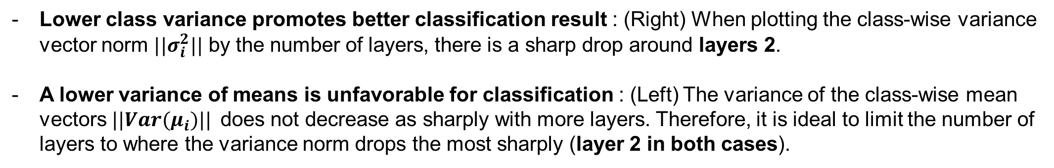
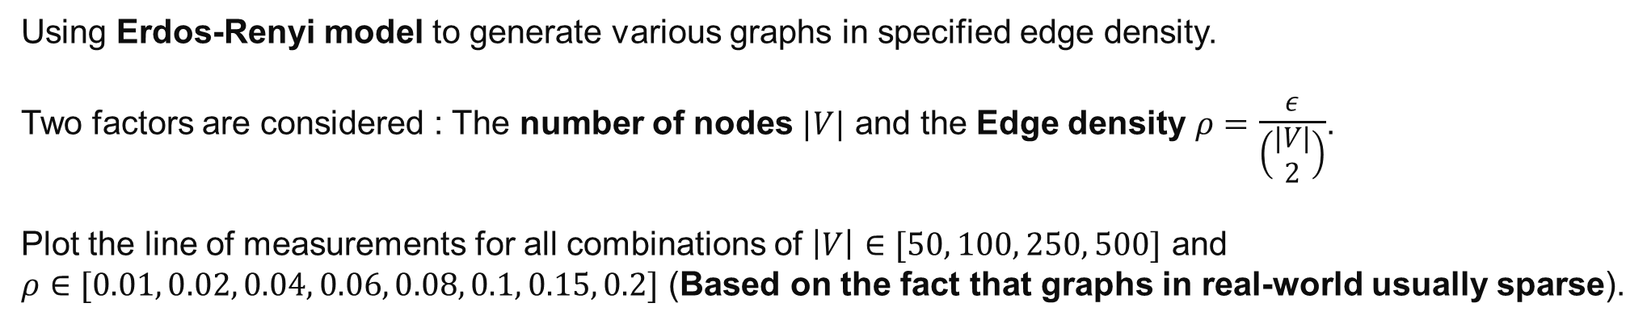
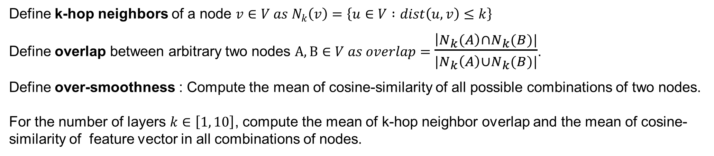
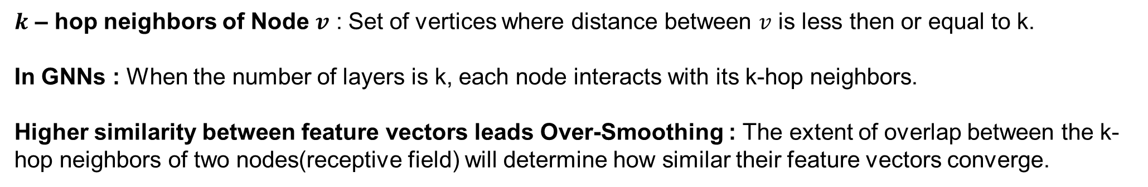
Team 47: Finding the optimal layer depth in GCN for best performance
CS471: Graph Machine Learning and Mining
KAIST
20190272 Junhyun Park
20190605 Inho Jung
20220554 Taeyoon Lee
Introduction
Experiment 1
Over-smoothing
Experiment Objective
With the increase of the network depth, node features of GNN tend to become more similar.
Finding the correlation between k-hop neighborhood of nodes and feature vector smoothness.
Hypothesis
Relation between ‘$k$ - hop neighbors’ and ‘Over-Smoothing’ ?
Nodes in GCN with k layers interacts with its k-hop neighbors.
It is reasonable that k-hop neighborhood overlapping is highly related with its over-smoothing possibility.
$k$ – hop neighbors of Node $v$ : Set of vertices where distance between $v$ is less then or equal to k.
In GNNs : When the number of layers is k, each node interacts with its k-hop neighbors.
Higher similarity between feature vectors leads Over-Smoothing : The extent of overlap between the k-hop neighbors of two nodes(receptive field) will determine how similar their feature vectors converge.
Details
Define k-hop neighbors of a node $v∈V as N_{k}\left(v\right)=\left\{u∈V :dist\left(u,v\right)≤k\right\}$
Define overlap between arbitrary two nodes $A,B∈V as overlap=$ $\frac{\left|N_{k}(A\right)∩N_{k}(B)|}{|N_{k}\left(A\right)∪N_{k}(B)|}$.
Define over-smoothness : Compute the mean of cosine-similarity of all possible combinations of two nodes.
For the number of layers $k∈\left[1, 10\right]$, compute the mean of k-hop neighbor overlap and the mean of cosine-similarity of feature vector in all combinations of nodes.
Objective
Investigate how to find the optimal number of layers of GCN in which over-smoothing problem least occur and get optimal result
1
2
Experiment 1 Result
Experiment 2
Experiment Objective
Does the density of graphs affect the measurement of overlap measurement and cosine similarities?
Hypothesis
The graph network (edge) density affects on the neighbor overlap or smoothness of feature vectors.
Details
We found a tendency that mean neighbor overlap and mean cosine similarity have similar shape, while it does NOT hold in sparse graph(Cora).
Furthermore, the curve of mean cosine similarity of feature vectors keeps its shape in both dense graph(Karate) and relatively sparse graph(Cora).
Using Erdos-Renyi model to generate various graphs in specified edge density.
Two factors are considered : The number of nodes $|V|$ and the Edge density $ρ=$ $\frac{ε}{\left(\begin{matrix}|V| \\ 2\end{matrix}\right)}$.
Plot the line of measurements for all combinations of $\left|V\right|∈[50, 100, 250, 500]$ and
(Based on the fact that graphs in real-world usually sparse).
Motivation to Experiment 2 : Two measurements does not well-aligned in sparse graph. It leads to another question, “Does the density of graphs affect the overlap measurement and cosine similarities?”
4
3
Experiment 2 Result
Experiment 3
Graph density does not significantly affect smoothing(orange line) beyond a certain scale (most graphs around layers 2~4).
The k-neighbor overlap(blue line) is significantly affected by density and is not suitable for explaining over-smoothing.
Experiment Objective
Find the number of layers where the difference among class means is large and the variance within a class is small.
Limitations : An increase in the overall mean of cosine similarities means all points converge in one direction, making classification difficult.
However, it does not explain the differences in class distributions.
Motivation to Experiment 3 : Class distributions should be distinguishable, meaning the difference between class means should be large, and the difference within a class should be small.
New hypothesis : The optimal point is at shallow layers(around layers 2~4), before a rapid increase of similarity.
Hypothesis
The optimal point is at shallow layers(around layers 2~4).
Details
- Using the Karate and Cora datasets, extract feature vectors by varying the number of GCN layers using the previous method.
- Calculate norm of the variance of the means $||Var(μ_{i})||$ and the L2 norm of the variance vectors $||σ_{i}^{2}||$ of each class.
- Plot these values according to the number of layers.
5
6
Experiment 3 Result
Conclusion
The overall k-hop neighborhood overlap of nodes may affect the cosine similarity of feature vectors. Also, this tendency fits well in dense graph.
However, the overall mean of cosine similarity cannot explain the ease of classification task.
We investigated the classification task into two different points of view: closeness of mean vectors of classes, and vector variance in each class. To classify the classes easily, the mean vectors of class should be distinguishable and vector variance of each class should be lower.
Class variance usually drops rapidly when the depth of network is shallow, while the mean variance shows relatively slower decrease. This can explain why GCN usually works well in shallow network depth.
According to Experiments above, the shallow layers(2 ~ 4, especially 2) is the optimal layer depth in GCN in best performance.
Lower class variance promotes better classification result : (Right) When plotting the class-wise variance vector norm $||σ_{i}^{2}||$ by the number of layers, there is a sharp drop around layers 2.
A lower variance of means is unfavorable for classification : (Left) The variance of the class-wise mean vectors $||Var(μ_{i})||$does not decrease as sharply with more layers. Therefore, it is ideal to limit the number of layers to where the variance norm drops the most sharply (layer 2 in both cases).
7
8

